Slide 1
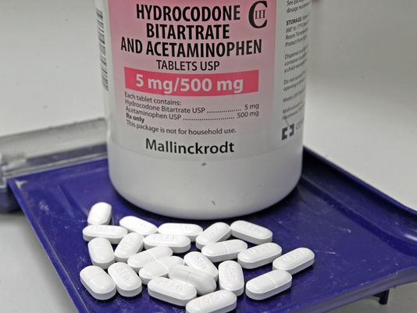
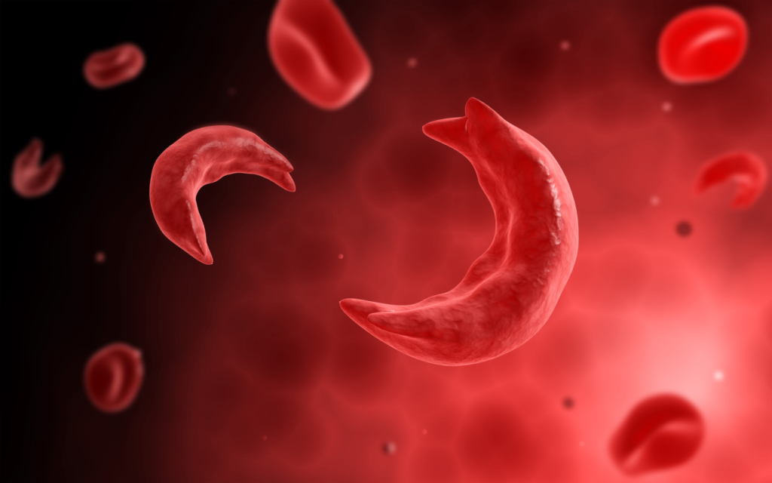
Opioid Prescribing in Sickle Cell Disease: Disparities and Realities
Wally R. Smith MD
Florence Neal Cooper Smith Professor of Sickle Cell Disease
Virginia Commonwealth University
Some slides courtesy Steve Prakken, MD
Chief Medical Pain Service
Duke Pain Medicine
Notes:
Why we are in this mess, what drove us to this time in history
What the assumptions are
What states did
Then our state
Then CDC
Then FDA recently
Where we stand now, way to stay safe
CSRS, OTF design, documentatio, etc.

Slide 2
Outline
How we got here
Disparities and Realities about SCD Pain and opioid use
Disparities and Realities about Opioid Prescribing Policy
Action steps for SCD community

Slide 3
Disparities and Realities about scd pain and Opioid use

Slide 4
The Iceberg: Proportion of Days in Pain, Crisis, Utilization
Intensity
Mean
Std
Dev
Above water
Utilization
6.5
2.3
3.5%
Submerged
Crisis w/o utilization
5.5
2.1
13.1%
39.3%
Pain w/o crisis, util.
4.2
2
44.1%
No Pain
0
0
PiSCES
*Percentage of days. Utilization= utilization with or without crisis or pain; Crisis= crisis without utilization; Pain= pain without crisis or utilization
Adapted from Smith WR, et. al. Ann Intern Med 2008 Jan 15, 148(2):94-101

Slide 5
Chronic Non-Cancer Pain (CNCP)
Pain that persists past the normal time of healing.
In practice this may be less than one month: 1994
More often, more than six months: 1994
Nonmalignant pain, three months is the most convenient point of division
Research purposes six months will often be preferred
International Association for the Study of Pain. Classification of Chronic Pain, Second Edition (revised)
https://www.iasp-pain.org/PublicationsNews/Content.aspx?ItemNumber=1673
Bonica 1953, 1979
Common
Significant burden to adult patients
Known to lower quality of life
Poorly managed
→anxiety and distress related to poor treatment
→negative long-term psychological effects
Kowal, John, et al. "Self-perceived burden in chronic pain: Relevance, prevalence, and predictors." Pain 153.8 (2012): 1735-1741.
Ferrell BR. The impact of pain on quality of life. Nurs Clin North Am. 1995;30(4):609-24.

Slide 6
Chronic SCD pain--AAPT
Diagnosis of SCD confirmed by laboratory testing, plus
Reports of ongoing pain present on most days over the past 6 months either in a single location or in multiple locations, and
One sign of pain sensitivity on palpation or with movement of the region of reported pain, decreased range of motion or weakness in the region of reported pain, or evidence of chronic disease complications (eg, skin ulcer, splenic infarct, or bone infarction) associated with the region of reported pain.
Three diagnostic modifications allowable
Chronic SCD pain without contributory disease complications
Chronic SCD pain with contributory disease complications
Chronic SCD pain with mixed pain types
Analgesic, Anesthetic, and Addiction Clinical Trial Translations Innovations Opportunities and Networks-American Pain Society Pain Taxonomy initiative.
Dampier C, Palermo TM, Darbari DS, Hassell K, Smith W, Zempsky W. AAPT Diagnostic Criteria for Chronic Sickle Cell Disease Pain. J Pain. 2017 May;18(5):490-498. doi: 10.1016/j.jpain.2016.12.016. Epub 2017 Jan 5. PubMed PMID: 28065813.

Slide 7
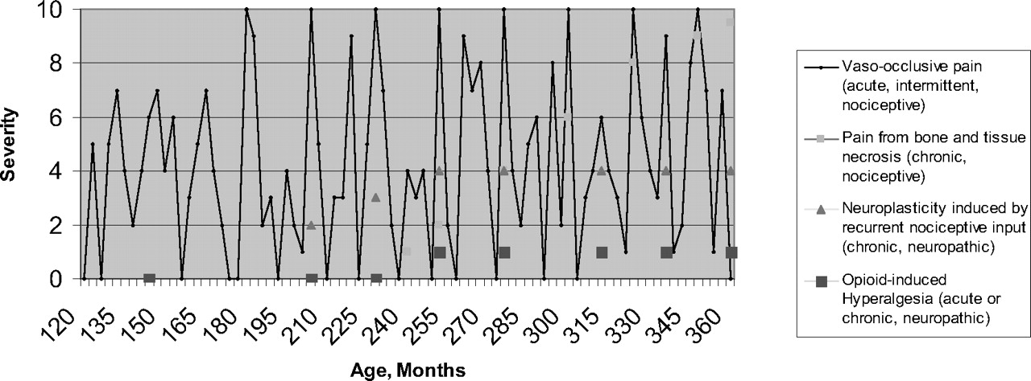
Evolution to Chronic Pain in SCD?

Slide 8
SCD Chronic Pain Mechanisms
Peripheral/nociceptive
SCD remittive agents
Peripheral neuropathic/sensitization
Central neuropathic/sensitization

Slide 9
The Neuropathic Pain Phenotype
After nerve injury maladaptive changes can occur in injured sensory neurons and along the entire nociceptive pathway within the CNS
Leads to spontaneous pain or pain hypersensitivity
The resulting neuropathic pain syndromes present as a complex combination of negative and positive symptoms, e.g.
Central sensitization—wind-up→ persistently high reactivity
Hyperalgesia-increased response to a (already) painful stimulus, e.g. pin prick.
Allodynia-painful response to a normally innocuous stimulus, e.g. q-tip.
Sx. vary enormously from individual to individual
1: von Hehn CA, Baron R, Woolf CJ. Deconstructing the neuropathic pain phenotype to reveal neural mechanisms. Neuron. 2012 Feb 23;73(4):638-52. Review. PubMed PMID: 22365541; PubMed Central PMCID: PMC3319438.

Slide 10
“Of all the remedies it has pleased almighty God to give man to relieve his suffering, none is so universal and so efficacious as opium.” ― Thomas Sydenham Father of English Medicine, author of Observationes Medicae which became a standard textbook of medicine for two centuries

Slide 11
Long-term Opioid Therapy (LtOT)
Opioid use for most days for >3 months
Chou R, Turner JA, Devine EB, Hansen RN, Sullivan SD, Blazina I, Dana T, Bougatsos C, Deyo RA. The effectiveness and risks of long-term opioid therapy for chronic pain: a systematic review for a National Institutes of Health Pathways to Prevention Workshop. Ann Intern Med. 2015 Feb 17;162(4):276-86. doi:10.7326/M14-2559. Review. PubMed PMID: 25581257.
An option for CNCP
Controversial
Previous ardent advocates have retreated from their advocacy
Catan T, Perez E. A pain-drug champion has second thoughts. The Wall Street Journal. 15 December 2012.

Slide 12
Opioids and Central Sensitization (CS) in SCD
Greater non-crisis pain on long-term opioid therapy (LtOT)
?confounding by indication for Rx
Greater depression on LtOT (? Comorbidity of chronic pain)
Greater CS on LtOT
Nociceptive processing in SCD patients on LtOT differs from those who are not
If NOT on LtOT, greater CS asso with greater non-crisis clinical pain
If on LtOT , no relationship between CS and non-crisis clinical pain
Hopkins Study: Temporal summation to measure CS
CS index=Z scores for thermal and mechnaical temporal summation, after sensations to temporal summation and hot water
CS index on LtOT vs not =0.34 vs -0.10.
QST index not significantly different
Carroll CP, Lanzkron S, Haywood C Jr, Kiley K, Pejsa M, Moscou-Jackson G, Haythornthwaite JA, Campbell CM. Chronic Opioid Therapy and Central Sensitization in Sickle Cell Disease. Am J Prev Med. 2016 Jul;51(1 Suppl 1):S69-77. doi: 10.1016/j.amepre.2016.02.012. PubMed PMID: 27320469; PubMed Central PMCID: PMC5379857.

Slide 13
PiSCES: Relationship of Pain to Opioid Use
 | Mean Pain Intensity on Pain Days (SD)* | Percent Pain Days (SD)⁺
 | 4.8 (1.5) | 81.9 (25.4)
 | 4.1 (1.4) | 51.9 (35.3)
 | 3.0 (1.2) | 16.8 (23.3)
 | 2.8 (2.0) | 12.3 (30.9)
LA=long-acting, SA=Short-acting.
*Mean pain on pain days, overall ANOVA p<0.0001.
All paired comparisons statistically significant except none vs non-opioid and none vs SA opioid.
⁺ Percent pain days, overall ANOVA p<0.0001.
All paired comparisons statistically significant except none vs. non-opioid
Fewer (38.8%) used LA opioids (w or w/o other analgesics) than used SA (47.0% w or w/o non-opioids)
9.6% only non-opioid, 4.6% none analgesics
Pain intensity, frequency higher with LA or higher total opioid
Smith WR, McClish DK, Dahman BA, Levenson JL, Aisiku IP, de A Citero V, Bovbjerg VE, Roberts JD, Penberthy LT, Roseff SD. Daily home opioid use in adults with sickle cell disease: The PiSCES project. J Opioid Manag. 2015 May-Jun;11(3):243-53. doi: 10.5055/jom.2015.0273. PubMed PMID: 25985809

Slide 14
What is Prescription Opioid Misuse?
Use in any way not directed by a doctor, including use without a prescription of one’s own, use in greater amounts, more often, or longer than directed.
Current misusers =3.8 million >11 year old
National Survey on Drug Use and Health (2015 revision)
Center for Behavioral Health Statistics and Quality. (2016). Key substance use and mental health indicators in the United States: Results from the 2015 National Survey on Drug Use and Health (HHS Publication No. SMA 16-4984, NSDUH Series H-51). Retrieved from http://www.samhsa.gov/data/
Significant risk factor for future or concurrent use of heroin.
Jones C.M.. Heroin use and heroin use risk behaviors among nonmedical users of prescription opioid pain relievers - United States, 2002-2004 and 2008-2010. Drug Alcohol Depend. 132(1-2): 95-100, 2013. 2013.01.007.

Slide 15
What are Tolerance, Physical Dependence, and Addiction?
Tolerance
neuroadaptation to the effects of chronically administered opioids
indicated by the need for increasing or more frequent doses to achieve initial effects
may occur both to the analgesic effects and to unwanted side effects
variable in occurrence, but does not, in and of itself, imply addiction
Physical dependence
physiological state in which abrupt cessation of the opioid, or administration of an opioid antagonist, results in a withdrawal syndrome.
expected after continuous use
does not, in and of itself imply addiction
Addiction
persistent pattern of dysfunctional opioid use that may involve:
adverse consequences associated with the use of opioids
loss of control over the use of opioids
preoccupation with obtaining opioids despite the presence of adequate analgesia
American Society of Addiction Medicine
https://www.asam.org/quality-practice/definition-of-addiction

Slide 16
SCD Opioid Addiction: Reality
High rate of TOLERANCE
Lower, but significant rate of PHYSICAL DEPENDENCE in daily opioid users
Low rate of ADDICTION

Slide 17
Balancing Act of Opioid Rx in CNCP
Don’t Prescribe (or Prescribe less)
Prescribe (or Prescribe more)
Legal Danger (from patients diverting or using recreationally)
Biological “risk” (from tolerance, central sensitization, physical dependence, addiction, overdose-related morb/mort)
Requires high trust of patient to doctor, doctor to patient
Unmet need
Pain subjective, but real
Pain difficult to measure
Pain is it’s own disease
Abuse and misuse alone don’t disqualify opioids as valid Rx

Slide 18
Don’t Prescribe (or Prescribe less)

Slide 19
Sharp increases in opioid prescribing coincides with sharp increases in Rx opioid deaths

Slide 20
“Trump says opioids are a national emergency. Here’s what happens next.”
“The opioid crisis is an emergency, and I'm saying officially right now it is an emergency,” Trump told reporters at his golf club in Bedminster, N.J.
Washington Post, August 10, 2017

Slide 21
Prevalence of Addiction in Pain Patients
Estimated 10% prevalence of addiction in gen. U.S. population
Estimated 6-15% rate of substance use disorders.
Prevalence of drug addiction in chronic pain patients = 3-19%.
Patients with SCD previously estimated at 1-3% prevalence.
Providers may withhold opiates for fear of causing addiction.

Slide 22
Benefits of Long-term Opioids
Anecdotal reports
Many patients report improvement in function, sleep, mood, pain.
School and work performance improved
Less outages
Improved muscle movement, exercise capacity at school and work
Indirect evidence
No other safe and effective alternatives
No new class of analgesics developed more efficacious
Ballantyne JC, Sin NS. Efficacy of opioids for chronic pain: A review of the evidence. Clin J Pain 2008;24:469-78.

Slide 23
Opioid Misuse and Addiction is difficult to diagnose in CNCP and SCD
Some VCU SCD patients at risk of opioid misuse as identified by the POMI (10 item screener)
26%
None were identified as addicted by the PDUQ (42 item confirmer)
No studies of SCD and SOAPP (instrument recommended by Chou, et al)
COMM (17 item) used in Hopkins study of central sensitization and opioids (>9 =problematic opioid meds)
COMM risk behavior subset score calculated, nearly 3 times higher if on LtOT

Slide 24
Prescribe (or Prescribe more)

Slide 25
Past Month Nonmedical Use in Age 12 and Older
Notes:
Past Month non medical use in age 12 and older SAMSU (double checked)

Slide 26
Va. Opioid deaths- A Different Perspective

Slide 27
Va. Fentanyl deaths (RX, Illicit, and Analogs)

Slide 28
Doctors And Nurses Overestimate The Prevalence Of Addiction in SCD
53% of ED MDs and 23% of hematologists felt > 20% of adult patients with SCD were addicted to opiates.
22% of ED MDs and 9% of hematologists believed that > 50% were addicted.
Shapiro BS, Benjamin LJ, Payne R, Heidrich G. Sickle cell-related pain: perceptions of medical practitioners. J Pain Symptom Manage. 1997 Sep;14(3):168-74. PubMed PMID: 9291703.
39 resident MDs estimated SCD rate of opioid addiction > chronic pancreatitis, chronic low back pain.
Most residents said experience rather than evidence was most important chronic pain management determinant.
This survey predated the current opioid epidemic
Sop D, Smith W, Alsalman A, Li Wong J, Fei D-Y, McClish D, Rafiq A, Coyne P, Johnson S, Lipato T. Survey of physician perspective towards management of pain for chronic conditions in the emergency department. Modern Clinical Medicine Research 1(3):October 2017; 55-70.

Slide 29
Short and Long-acting Opioids, MSH (ca. 1992)
Opioid | Frequency
(listed in order of frequency) | % of all diaries (n=16818) | % of diaries with any opioid useª (n=10071) | % of reported medications (n=11302)
Any opioid | 59.9 | 100.0 | 100.0
Oxycodone | 23.2 | 39.1 | 34.4
Codeine | 18.3 | 31.0 | 27.3
Meperidine | 6.7 | 11.4 | 9.9
Hydromorphone | 6.6 | 11.2 | 9.9
Hydrocodone | 5.4 | 9.0 | 8.0
Morphine | 3.3 | 5.6 | 5.0
Methadone | 1.4 | 2.3 | 2.0
Propoxyphene | 0.9 | 1.6 | 1.4
Levorphanol | 0.3 | 0.5 | 0.4
Fentanyl (patch) | 0.3 | 0.5 | 0.5
ªTotals in this column sum to more than 100% due to multiple medication use at some visits

Slide 30
PiSCES: No., %people who ever took specific medications
Oipioid | No. (%), All Subjects( N=188)*
Long-acting opioids
Oxycodone | 19 (10.1)
Morphine | 44 (23.4)
Methadone | 24 (13.0)
Fentanyl | 16 ( 8.5)
Any of the above long-acting | 85 (45.2)
Short-acting opioids (including combination analgesics)
Codeine | 37 (19.7)
Oxycodone | 77 (41.0)
Morphine | 53 (28.2)
Hydromorphone | 48 (25.5)
Hydrocodone | 31 (16.5)
Meperedine | 18 ( 9.6)
Propoxyphene | 6 ( 3.2)
Tramadol | 3 ( 1.6)
Any of the above short-acting | 177 (94.2)
Non-opioid analgesics (on days with no opioids)
Aspirin, | 9 (4.1)
Acetaminophen | 46 (21.0)
NSAIDs | 70 (32.0)
Any of the above non-opioid analgesics | 94 (42.9)
Adjuvants
Antihistamines | 35 (18.6)
Anxiolytics/antidepressives/sedatives | 23 (12.2)
Muscle relaxants | 11 (5.9)
Anticonvulsants | 6 (3.2)
Any of the above adjuvants | 54 (24.7)
Adults with SCD (n=219)
Used opioids on 12,311 (78 percent) of 15,778 home pain days.
*31 of 219 subjects did not use opioids on pain days.
Smith WR, McClish DK, Dahman BA, Levenson JL, Aisiku IP, de A Citero V, Bovbjerg VE, Roberts JD, Penberthy LT, Roseff SD. Daily home opioid use in adults with sickle cell disease: The PiSCES project. J Opioid Manag. 2015 May-Jun;11(3):243-53. doi: 10.5055/jom.2015.0273. PubMed PMID: 25985809

Slide 31
Opioid-Related Mortality Not an Issue in SCD
Year | ORM in Non-SCD Patients | ORM in SCD Patients
1999 | 4,022 | 8
2000 | 4,393 | 7
2001 | 5,521 | 7
2002 | 7,450 | 6
2003 | 8,513 | 4
2004 | 9,856 | 1
2005 | 10,922 | 6
2006 | 13,717 | 6
2007 | 14,401 | 7
2008 | 14,795 | 5
2009 | 15,594 | 3
2010 | 16,641 | 10
2011 | 16,907 | 10
2012 | 16,002 | 5
2013 | 16,225 | 10
Totals | 174,959 | 95
Ruta NS, Ballas SK. The Opioid Drug Epidemic and Sickle Cell Disease: Guilt by Association. Pain Med. 2016 Oct;17(10):1793-1798. Epub 2016 May 5. PubMed PMID:27152018.

Slide 32
ORM Not an Issue in SCD
Cause of Death | Total Number of Deaths Due to All Causes | ORM | Percentage
Heart Disease | 20,595,492 | 21,656 | 0.11
Fibromyalgia | 3,282 | 144 | 4.4
Low Back Pain | 3,758 | 80 | 2.1
Migraine | 2,286 | 103 | 4.5
Sickle Cell Disease | 12,261 | 95 | 0.77
Ruta NS, Ballas SK. The Opioid Drug Epidemic and Sickle Cell Disease: Guilt byAssociation. Pain Med. 2016 Oct;17(10):1793-1798. Epub 2016 May 5. PubMed PMID:27152018.

Slide 33
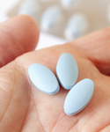
Opioid Backlash Threatens Sickle Cell Care
by
Dec 19, 2013
Sophie Lanzkron, MD, MHS Advertisement
The well-meaning push to curb opioid prescribing could worsen healthcare for sickle cell patients. Clinicians tend to undertreat the substantial pain experienced by many sickle cell patients and treat them as drug addicts. However, research does not support increased risk of addiction in this patient population…..
Challenging Pain, Few Options
Unfortunately, subduing sickle cell pain often requires high doses of opioids, perhaps due to patients’ high morphine clearance rates or because they may simply need more medication than others to reach the same plasma level. None of this negates the need to monitor patients for drug addiction or diversion. Those who provide continuity of care to these patients should shoulder this burden.
Despite their risks, opioids remain indispensable for treating sickle cell pain. Efforts to rein in over­prescribing must not ignore the needs of these undertreated patients.

Slide 34
“War on Opioids Hurts Sickle cell Disease Patients”
Sickle Cell Disease Sufferers Trapped in Fight Against Opioid Scourge
Dallas Weekly, July 19, 2017
http://www.dallasweekly.com/health/article_786129b4-7918-11e7-899b-ef54de21cbf7.html
“According to Judy Anderson, the executive Director of the Sickle Cell anemia Association of Hampton Roads, VA, … ‘One lady who called the office Monday, July 10th, told me she took her last pain pill the previous Friday. Her doctor is reviewing her case and has not written her a new prescription. Unable to get her pain meds, I am sure she will end up in a hospital, because she went to the emergency room to have her pain treated.’”

Slide 35
Sickle cell sufferer fears opioid crisis could leave more patients suffering
RICHMOND, Va., Nov 21, 2017 (WRIC, Morgan Dean) -- President Donald Trump has called the opioid epidemic a national health crisis. As the government tries to curb the numbers of pills and drugs out there, sickle cell patients are afraid they could be left to suffer in pain.
George Carter, an administrator of Sickle Cell Chapters of Virginia and a sickle cell sufferer himself, told 8News Anchor Morgan Dean the only thing that can take away the pain is powerful pain killers.
"That pain can be excruciating," Carter said. "Three times in my life, that pain was so great, I prayed to God to let me die because I didn't think I could stand it anymore."
Those pain relievers are now in the governments crosshairs in the war on drugs.
CVS announced this fall that it will only fill opioid prescription for seven days and insurer Cigna announced it won’t cover OxyContin in the future, but only generics of the drug.

Slide 36
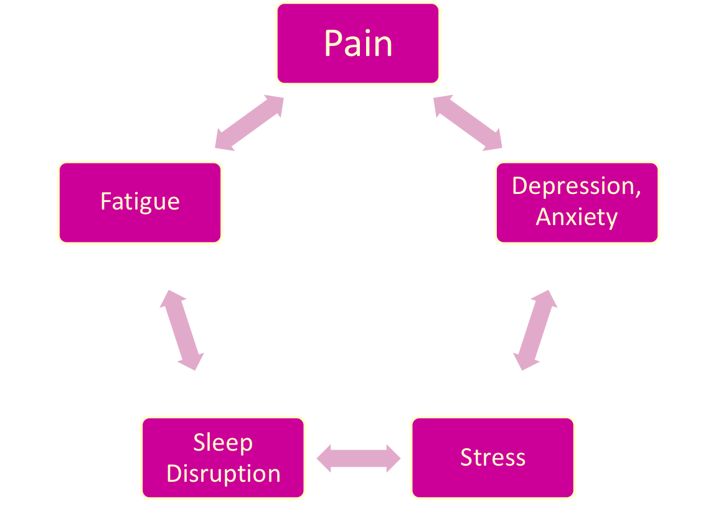
Vicious Cycle of SCD Pain

Slide 37
Inpatient Opioid Use Curbed by Rivapansel
Cumulative parenteral opioid use. MEU mg/kg | GMI-1070 | Placebo (p=.010)
Mean (SD) | 12.92(20.8) | 57.91 (109.8)
Telen, et. Al Blood 2015

Slide 38
SCD BMT Allows Tapering Of Opioids
Takes weeks
Data, courtesy Tisdale, et al.

Slide 39
ED Use NOT Predictor of Opioid Use in SCD
High ED utilizers (35% of the sample) did not use opioids more frequently than other pts.
after controlling for severity and frequency of pain
Aisiku IP, Smith WR, McClish DK, Levenson JL, Penberthy LT, Roseff SD, Bovbjerg VE, Roberts JD. Comparisons of High Versus Low Emergency Department Utilizers in Sickle Cell Disease. Ann Emerg Med. 2009 May;53(5):587-93.

Slide 40
Dilemma
If opioids were determined to be neither safe nor effective in CNCP, what would we replace them with?
How would we wean millions of CNCPs off opioids?
Who would pay for the drug treatment, hospitalizations for pain and withdrawal, loss of income and employment, and defense against the public/press likely to result from this weaning?

Slide 41
Reality and myth about opioid prescribing policy

Slide 42
Forces impacting decisions
CDC
State Boards of Medicine
Food and Drug Administration
Drug Enforcement Agency
Quality improvement standards
Shrill opinions
Other physicians
Patients

Slide 43
Opioid Prescribing Guidelines
Early Guidelines
Pain societies (1990s-2000s)
NHLBI Consensus Panel
NIH Pathways to Prevention Workshop Recommendations
2014
Interagency Pain Research Coordinating Committee Recommendations
2015
CDC Opioid Prescribing Guidelines
2016

Slide 44
NHLBI Expert Consensus Panel, 2014
Eligible Studies reviewed
32 RCTs with more than 1,800 people of all ages
34 observational studies
30 case reports
Highest quality evidence, strongest recommendation for opioids within 30-60 minutes of arrival in the Emergency Department.
Evidence from several RCTs and observational studies supports opioids for VOCs.
Indirect, high-quality evidence from populations without SCD also supports opioids for VOCs.
RCTs and observational studies support NSAIDs, were conflicting, but reduced pain decreased LOS
Several RCTs and observ.’s support the use of around-the-clock dosing vs intermittent for VOCs.
National Institutes of Health. U.S. Department of Health and Human Services. Evidence-based Management of Sickle Cell Disease. Expert Panel Report. 2014
Yawn BP, Buchanan GR, Afenyi-Annan AN, Ballas SK, Hassell KL, James AH, Jordan L, Lanzkron SM, Lottenberg R, Savage WJ, Tanabe PJ, Ware RE, Murad MH, Goldsmith JC, Ortiz E, Fulwood R, Horton A, John-Sowah J. Management of sickle cell disease: summary of the 2014 evidence-based report by expert panel members. JAMA. 2014 Sep 10;312(10):1033-48. doi: 10.1001/jama.2014.10517. Review. Erratum in: JAMA. 2015 Feb 17;313(7):729. JAMA. 2014 Nov 12;312(18):1932. PubMed PMID: 25203083.

Slide 45
LtOT for CNCP: Systematic Review for NIH Pathways to Prevention Workshop 2015
Conclusion: Evidence is insufficient to determine the effectiveness of LtOT for improving CNCP and function.
Evidence supports a dose-dependent risk for serious harms.
Meta analysis could not be done
Publication bias could not be assessed
No placebo-controlled trials met inclusion criteria
Evidence was lacking for many comparisons and outcomes
Observational studies limited ability to address potential confounding
Chou R, Turner JA, Devine EB, Hansen RN, Sullivan SD, Blazina I, Dana T, Bougatsos C, Deyo RA. The effectiveness and risks of long-term opioid therapy for chronic pain: a systematic review for a National Institutes of Health Pathways to Prevention Workshop. Ann Intern Med. 2015 Feb 17;162(4):276-86. doi:10.7326/M14-2559. Review. PubMed PMID: 25581257.

Slide 46
The Interagency Pain Research Coordinating Committee (IPRCC) 2015
Federal advisory committee
Created by the Department of Health and Human Services
Goals
Enhance pain research efforts and
Promote collaboration across the government,
Ultimately, advance the fundamental understanding of pain and improve pain-related treatment strategies
Summary:
Endorsed a population-based, disease management approach to pain care that is delivered by integrated, interdisciplinary, patient- centered teams and is consistent with real-world experience.
Did not address LtOT for CNCP
Released May 20th, 2015
http://iprcc.nih.gov/National_Pain_Strategy/NPS_Main.htm

Slide 47
IPRCC NIH Pain in SCD Portofolio Analysis: Gaps & Opportunities
Missing studies characterizing SCD pain phenotype(s) or diagnosis/case definitions
Ischemic nocioceptive
neurological
inflammatory
Biobehavioral
psychosocial
Missing studies developing analgesics, device, and therapy delivery systems targeted at these mechanisms.

Slide 48
CDC Recommendations 3/16
Intended for Primary Care Providers: Internists, Family Practitioners, and Mid-levels (NP, PA) in OUTPATIENT setting
Not for cancer pain, palliative care, end-of-life care
Age >18 years!
Voluntary Guidelines!
Define chronic pain as lasting “>3 months or past the time of normal tissue healing”
Not the first (or last): APS/AAPM, ASA, VA, Washington State have all published their own guidelines
“Offers clarity on recommendations”
GRADE method of clinical evidence

Slide 49
CDC Opioid Guidelines, March 2016
Nonopioid therapy is preferred for chronic pain outside of active cancer, palliative, and end-of-life care.
When opioids are used, the lowest possible effective dosage should be prescribed to reduce risks of opioid use disorder and overdose.
Providers should always exercise caution when prescribing opioids and monitor all patients closely.

Slide 50
On Thursday, 3/16/2016 the U.S. Food and Drug Administration began requiring warning labels on opioids and benzodiazepines — nearly 400 products in total — with information about the potentially fatal consequences of taking these medications at the same time.

Slide 51
How the guidelines came to be:
Guidelines drawn up from research 2008 to 2014
“Core Expert Group”
Subject matter experts (“appropriate academic/clinical training, proven scientific excellence in opioid prescribing”, representatives of primary care professional societies/state agencies
CDC excluded anyone with conflict of interest or perceived conflict of interest
Offered their guidance on draft recommendations: no voting/consensus
CDC chose what to change or not; they had no preview of final draft

Slide 52
CDC Guideline Negative Impacts
For the sickle cell community, the most egregious CDC guideline relates to morphine milligram equivalents (MME)/day of prescribed opioid.
Lifetime of Rx, high tolerant, no evidence of high opioid-related mortality

Slide 53
Most Egregious CDC Guideline—Dose Limitation
When opioids are started, clinicians should prescribe the lowest effective dosage.
Clinicians should use caution when prescribing opioids at any dosage, should carefully reassess evidence of individual benefits and risks when considering increasing dosage to ≥50 morphine milligram equivalents (MME)/day
Clinicians should avoid increasing dosage to ≥90 MME/day or carefully justify a decision to titrate dosage to ≥90 MME/day
Recommendation category: A, evidence type: 3.

Slide 54
Problem with the Dose Limitation Guideline-1
The adjusted hazard ratio (HR) for any overdose event (consisting of mostly nonfatal overdose)
1.44 for 20 to 49 MME/day
3.73 for 50–99 MME/day
8.87 for ≥100 MME/day
The guidelines agreed that there may be variations in safe levels based on tolerance, various indications, and exceptions.
Large % of chronic pain SCD patients on hundreds, thousands of MME.
For SCD tolerant patients, these hazard ratios likely don‘t apply.

Slide 55
Problem with the Dose Limitation Guideline-2
Many have taken those suggested MME maximum levels as ABSOLUTES.
Some physicians have (had) prescribing limits of >100 MME/day (or other).
“We finally have a level of opioid prescribing that constitutes unsafe prescribing.”
>100 MME viewed as aberrant, out of the standard-of-care, and maybe criminal.
Others have now STOPPED PRESCRIBING.
Encourages prescribing physicians to accuse patients of addiction.

Slide 56
Problem with the Dose Limitation Guideline Part 3
Worse, many have taken those suggested MME maximum levels as ABSOLUTES. Prescribing above 90 MME/day is now more likely to be viewed as aberrant, out of the standard-of-care, and maybe even as a criminal act. When people refer to the CDC guidelines, the main thing they point out is this part of the guideline. “We finally have a level of opioid prescribing that constitutes unsafe prescribing.”
All along, some physicians have had mental models of some level of MME/day above which they would not prescribe. Anecdotally, these were often generalists treating sickle cell patients who were tolerant. SCD patients were still in unbearable pain, and prescribing physicians were accusing patients of addiction.

Slide 57
Federation of State Medical Boards
Long history, since 1912
Initially suggesting more aggressive tx
1998 protection from legislative action for even large opioid dosing.
2004 suggesting states make under-treatment punishable
2013 largest shift in course, suggesting the need for more thoughtful opioid prescribing.
Notes:
See above time line
Then to the 2012 statement with the elements noted.

Slide 58
Federation of State Medical Boards
Development of a Treatment Plan and Goals
Informed Consent and Treatment Agreement
Initiating an Opioid “Trial”
Ongoing Monitoring and Treatment Adaptation
Periodic Drug Testing
Consultation and Referral
Discontinuing Opioid Therapy
Medical Records

Slide 59
State Laws
Mandated Prescription Drug Monitoring Programs (PDMP)
All but 1
Mandated checking of PDMP
Mandated opioid limits
Total counts
Total days per script
Notes:
Prescription Drug Monitoring Programs all but Missouri
Mandated checking of PDMP

Slide 60
Medicaid Changes
Considering
Lowering total dose (MMEQ)
Lowering pill count
14 days of open use, then PA

Slide 61
Action steps for SCD community

Slide 62
Actions Taken to Modify Guideline During Public Comment Period
During the period of public comment on the CDC guideline, we as members of the Interagency Committee on Pain Research Coordinating Committee wrote against this move, suspecting all of the above unintended consequences, and yet knowing that, to maintain internal Federal consistency, we would eventually be forced to refer to the CDC guidelines as representative of our own stance. Though we were against this part of the guideline, we now refer to the CDC guidelines in our National Pain Strategy https://iprcc.nih.gov/National_Pain_Strategy/NPS_Main.htm.

Slide 63
What to do?
Follow OTF, State and CDC
Similar goals and intention
Right Patient and the Right Time
Risk factors medical and psych
Cost benefit analysis
Documentation
Show your thinking
Functional goals
Benzo use with opioids, avoid
CSRS, CSRS, CSRS
UDS

Slide 64
Evidence-Based –based Approach to LtOT Rx
Weigh harms and benefits
Make shared decisions with patients about LtOT for CNCP.
Nicolaidis C. Police officer, deal-maker, or health care provider? Moving to a patient-centered framework for chronic opioid management. Pain Med 2011;12(6):890-7.

Slide 65
Safe Prescribing is not easy
Primary care vs. specialist(s) job?
Placing fear of loss of licensure in context with needs of patient
Monitoring
Chemical
Survey
Vigilance for clues
Willingness to withhold opioids while continuing to care for patient
Willingness to prescribe while monitoring

Slide 66
Pain in SCD: Summary, Conceptual Model
Begins as purely acute-on-chronic, multi-local vaso-occlusive, ischemic and inflammatory pain
Phenotype transformation to central and/or peripheral neuropathic pain?
Mechanisms of phenotype transformation?
Summative ischemia on neurons?
Genetic predisposition (different than 6 beta Hb Val->Glu)
Threshold effect?
Timing?
Relationship to psychosocial variables?
Mechanisms shared in common with other syndromes?
Approaches to Rx (besides HU and transplant)
Opioid?
non-opioid chemical?
Other, including biobehavioral?

Slide 67
Dx and Rx for Central neuropathic/Sensitization
Diagnosis
Quantitative Sensory Testing: Temporal summation
fMRI
High pain=more resting –state pronocicpetive connectivity on fMRI
HU use with more fetal Hb=low pain, more antinociceptive connectivity on fMRI
Darbari DS, Hampson JP, Ichesco E, Kadom N, Vezina G, Evangelou I, Clauw DJ, Taylor Vi JG, Harris RE. Frequency of Hospitalizations for Pain and Association With Altered Brain Network Connectivity in Sickle Cell Disease. J Pain. 2015 Nov;16(11):1077-86. doi: 10.1016/j.jpain.2015.07.005. Epub 2015 Aug 18. PubMed PMID: 26291276; PubMed Central PMCID: PMC4986827.
Treatment
Serotonin and norepinephrine reuptake inhibitors (SSNRIs)
Gabapentinoids
Tricyclics
Darbari DS, Ballas SK, Clauw DJ. Thinking beyond sickling to better understand pain in sickle cell disease. Eur J Haematol. 2014 Aug;93(2):89-95. doi: 10.1111/ejh.12340. Epub 2014 May 16. Review. PubMed PMID: 24735098.
Trifluoperazine?
Molokie RE, Wilkie DJ, Wittert H, Suarez ML, Yao Y, Zhao Z, He Y, Wang ZJ. Mechanism-driven phase I translational study of trifluoperazine in adults with sickle cell disease. Eur J Pharmacol. 2014 Jan 15;723:419-24. doi: 10.1016/j.ejphar.2013.10.062. Epub 2013 Nov 7. PubMed PMID: 24211787; PubMed Central PMCID: PMC3959657.

Slide 68
Sickle Cell Advocate Wins Fight for High-Dose Opioids in Virginia
George H. Carter
Administrator, lobbyist for Sickle Cell –Virginia
Pushed through regulation change to allow SCD physicians to provide higher levels of opioids without forced justification
Effective Aug 8, 2018
SCD joins cancer and terminal conditions in hospice or palliative care

